Slide 1
MACHINE LEARNING PROJECT

Slide 2
Team Members:
Anusha
Dhanalakshmi
Gowtham
Sanjai

Slide 3
Agenda
Introduction
Why we have chosen this topic
How this topic has impact on real life.

Slide 4
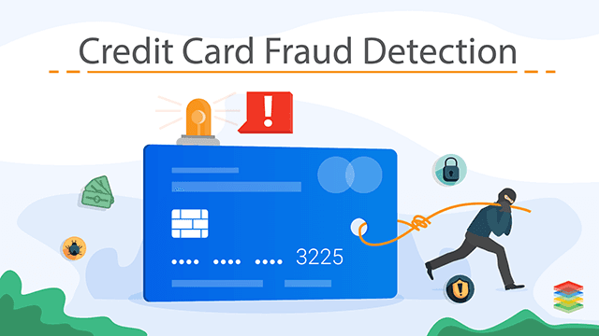
TOPIC : CREDIT CARD FRAUD RECOGNITION

Slide 5
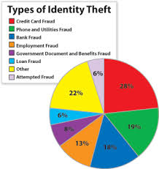

Slide 6
What is Credit Card Fraud Detection
Credit card fraud detection is a set of methods and techniques, designed to block fraudulent purchases, both online and instore.
This is done by ensuring that you are dealing with the right card holder and that the purchase is legitimate.

Slide 7
Objective of Credit Card Fraud Detection
Credit card fraud detection is a set of activities undertaken to prevent money or property from being obtained through false pretenses.

Slide 8
WHY CREDIT CARD FRAUD RECOGNITION
Over the past few years, especially after the pandemic, there has been a notable surge in credit card issuances, especially among the urban population.
Moreover, the credit card industry in India has undergone a significant transformation, introducing streamlined and online credit card application processes. This shift has led to the availability of diverse credit card options tailored to cater to specific needs.
Credit cards have transformed the way we handle transactions, offering convenience and flexibility. However, as the credit card usage surges, the risk of credit card fraud also increases.
As we are moving towards the digital world - cybersecurity is becoming a crucial part of our life.
A total of 3,432 fraud cases were filed in 2023, indicating an approximate 20% rise compared to the previous year.

Slide 9
Some estimates say less than 1% of credit card fraud is actually caught, while others say it could be higher but is impossible to know.
The truth is that most credit card fraud does go undetected, which is a major reason why it's become a favorite among crime rings and fraudsters.
Dealing with credit card fraud can be time-consuming. Cardholders typically need to contact their bank or credit card company, report the fraud, and go through a dispute process. This can take several weeks to resolve.
Around 39% of families in a survey claimed to have experienced financial fraud in the last 3 years and only 24% of them got their funds back.
Geolocation and IP Tracking: Checking the location of the transaction against the cardholder's usual location or verifying the IP address to detect potential fraud.
Economic Impact: Credit card fraud has a broader economic impact, as it can lead to higher costs for financial institutions, merchants, and consumers. These costs can be passed on to consumers in the form of higher fees and prices for goods and services.

Slide 10
How does Credit Card Fraud have impact in real life.
Every fraudulent cases are not reported.
When a person's credit card is used fraudulently, they can suffer immediate financial losses. These may include unauthorized charges for purchases they didn't make. Depending on the cardholder's liability, they may be responsible for some or all of these charges.
Experiencing credit card fraud can erode a person's trust in financial institutions and online payment systems. They may become more cautious about online shopping and sharing their financial information.

Slide 11
Fraud is not a victimless crime.
Fraud can be a traumatic experience that often causes real and irreversible impacts for victims and their families.
Fraud can also cause lasting mental and physical trauma for victims. Fraud also results in lost opportunities for individuals and businesses.
Enormous Data is processed every day for credit card frauds.
Most of the data are not fraudulent, hence it is really hard to for detecting the fraudulent transactions happening.

Slide 12
Fraud undermines the government’s ability to deliver services and achieve intended outcomes.
Money and services are diverted away from those who need it and the services delivered can be substandard or unsafe.
Fraud can result in distorted markets where fraudsters obtain a competitive advantage and drive out legitimate businesses.
Costs for dealing with fraud against government programs are significant and go well beyond the direct financial loss. They can include assessment, detection, investigation and response costs as well as potential restitution. In addition, further costs can include program reviews and audits, and retrofitting or redesigning programs.
Government entities generally lose between 0.5% and 5% of their spending to fraud and related loss based on international estimates. The majority of fraud is undetected and can be difficult to categorize.

Slide 13
Costs for dealing with fraud against government programs are significant and go well beyond the direct financial loss. They can include assessment, detection, investigation and response costs as well as potential restitution. In addition, further costs can include program reviews and audits, and retrofitting or redesigning programs.
Government entities generally lose between 0.5% and 5% of their spending to fraud and related loss based on international estimates. The majority of fraud is undetected and can be difficult to categorize.

Slide 14
How Machine Learning is helping?
Analyze the data.
Using Machine Learning Algorithms we will try to figure out what is the status of credit card frauds happening.
How we can figure out to reduce the frauds.

Slide 15


